Slide 1
DETECTION OF EVENTS FROM BIOMEDICAL DOCUMENTS AND DEDUCTION OF RELATIONS AMONG EVENTS
Student name: Inshuya M
Roll No. : 2015207001
Name of the Guide: Dr. T V Geetha
Senior Professor
Department of Computer Science and Engineering

Slide 2
Introduction
With the exponential growth of information, it is becoming increasingly difficult to find the knowledge submerged in Biomedical documents.
A lot of work has been done on biomedical event extraction focusing on rule-based and machine learning techniques.
Events are things that happen or occur; they involve entities (people, objects, etc.) who perform or are affected by the events .

Slide 3
Introduction – Contd.
This project addresses the problem of extracting such events from biomedical documents.
Moreover, the relationship that exist among these events are of significance.
Hidden relations between these events are also deduced
The identified relations can be mapped onto the respective documents, which enriches the knowledge about the document.

Slide 4
Literature Survey
Paper Details | Summary | Algorithm Used/Proposed | Pros | Cons
Title: Biomedical event trigger detection by dependency-based word embedding Year:2016 | Aims to identify and classify triggers with help of neural network and word-embedding | Neural Network | Proves word embedding shows better result for trigger classification | Learns from a very small training data
Title: A semi-supervised learning framework for biomedical event extraction based on hidden topics Year:2015 | Provides an entire framework for trigger identification and argument identification | Support Vector Machine(SVM) | Finds both simple and complex events | Works only for events within a sentence

Slide 5
Literature Survey – Contd.
Paper Details | Summary | Algorithm Used/Proposed | Pros | Cons
Title: Inferring Implicit Causal Relationships in Biomedical Literature Year:2016 | Aims to find out the relations between the events which may or may not be in the same sentence | Support Vector Machine(SVM) | Works for events which are not inside the boundary of a single sentence | Proved good only for chemical and disease scenario
Title: Joint Extraction of Events and Entities within a Document Context Year:2016 | Proposes novel model architecture for joint extraction of entities and events. Doesn't follow the conventional pipeline | Integer Linear Program(ILP) | Better accuracy in argument detection | Joint Model extraction are yet to be established

Slide 6
Literature Survey – Contd.
Paper Details | Summary | Algorithm Used/Proposed | Pros | Cons
Title: A generative model of words and relationships from multiple sources Year:2015 | Aims at finding hyponym of possible words in a document and define the relationship between them | Random Forest Classifier | Multiple data sources perform good on this model | -
Title: Dependency-Based Word Embeddings Year:2014 | Proposes an improved version of skip-gram model for learning dependency-based word embedding | Skip-gram Model | Efficient in learning dependency-based vectors for words | -

Slide 7
Overall Block Diagram
Discovering Relations between Biomedical Concepts
Representation of concepts in documents by vectors
Classification of Documents
Concepts-triplet Identification
Inference of Hidden Relation between concepts
Discovering Biomedical Events and Relations among them
Event-Event Relation Discovery
Trigger word Identification and Classification
Argument detection
Based on Event Features
Based on Word Embedding
Based on Concepts

Slide 8
Phase II Block Diagram
Trigger word Classification
L
o
o
k
u
p
T
a
b
l
e
Linear Context-based Word Embedding
Dependency-based
Word Embedding
GENIA Event Corpus
Pre-processing
Sentence Splitting
Tokenization
Dependency Parsing
PubMed Corpus
Dependency-based
Word embedding
Context-based Word Embedding
Building Trigger Dictionary
Distributed Semantic Feature Vector
Trigger Word Identification & Classification
Training Neural Network Model for Classification
Identifying and Classifying Trigger Words
Trigger Words and their types

Slide 9
Phase II Block Diagram – Contd.
Argument Detection
Feature Extraction
GENIA Event Corpus
Sentence Tree Parsing
Vector Construction of Fragments
Sentence
Merging Vectors
LDA Topic Modelling
Representing Topics with Vectors
Identifying Arguments
Finding Similar Sentences
(KNN Algorithm)
Finding Arguments
(Annotation Algorithm)
Arguments

Slide 10
Phase II Block Diagram – Contd.
Trigger word Classification
GENIA Event Corpus
Acquiring Positive & Negative Sample
Feature-based Relation Extraction
Word Embedding-based Relation Extraction
Concept-based Relation Extraction
Feature Extraction
Unigram Representation
Bigram Representation
POS tags
Number of triggers
Number of arguments
Trigger type
Linear Context-based
Word-embedding
(Triggers & arguments)
Acquiring Bio-medical concepts in the events
Summation of learnt embedding
Inferring relationship among the concepts
Vector Representation
Classification
(Related/Not)
Random Forest Classifier
Identifying related events
Classification
(Related/Not)
Linear SVM Classifier

Slide 11
Phase II Block Diagram – Contd.
Event-based Document Retrieval
Event-Event Relations
Events
Event-Based Document Retrieval
Top n Documents
Identified Events
Identified Related Events

Slide 12
List of Modules
Linear Context-Based Word Representation
Dependency-Based Word Representation
Trigger Identification and Classification
Argument Detection
Feature-Based Relation Extraction
Concept-Based Relation Extraction
Word Embedding-Based Relation Extraction
Event-based Biomedical Document Retrieval

Slide 13
1. Linear Context-Based Word Representation
Input : GENIA Event-Corpus
Output : Linear Context-Based Vector Representation of words
Algorithm :
Split the source text into sequence of sentences
Break the sentences into words, phrases and symbols
Use “word2vec” to convert sequence of words into linear context-based word representation

Slide 14
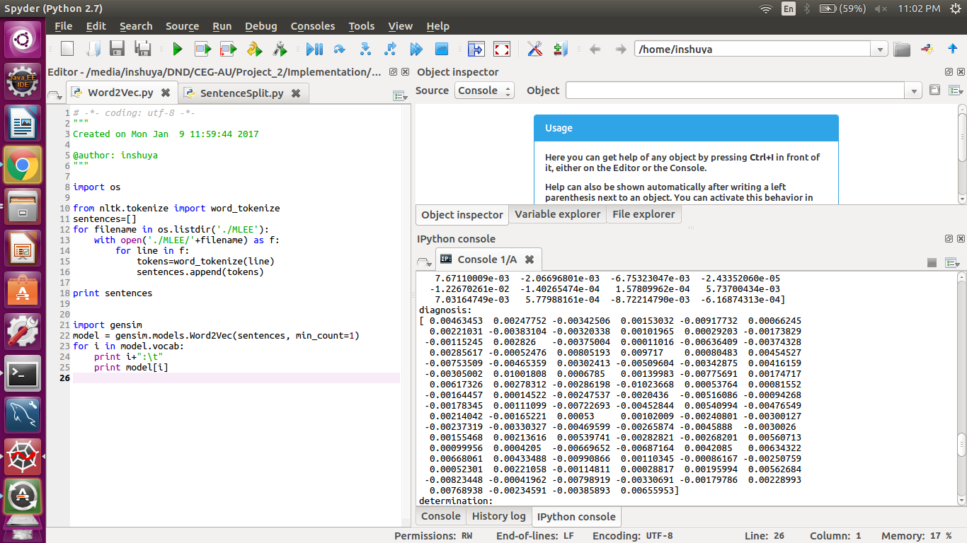
Output - Screenshot
Linear Context-Based Word embedding

Slide 15
2. Dependency-Based Word Representation
Input : PubMed/MEDLINE Corpus
Output : Dependency-Based Vector Representation of words
Algorithm :
Acquire a local copy of PubMed/MEDLINE data
Perform deep dependency parsing on the text acquired(For each sentence)
Use extended version of skip-gram model to learn the word embedding
Input : (word, context) pair
Here context is result of dependency parsing
Train neural network to maximize P(D=1|w,c)
Where D=1, implies that the pair of word and context came from data

Slide 16
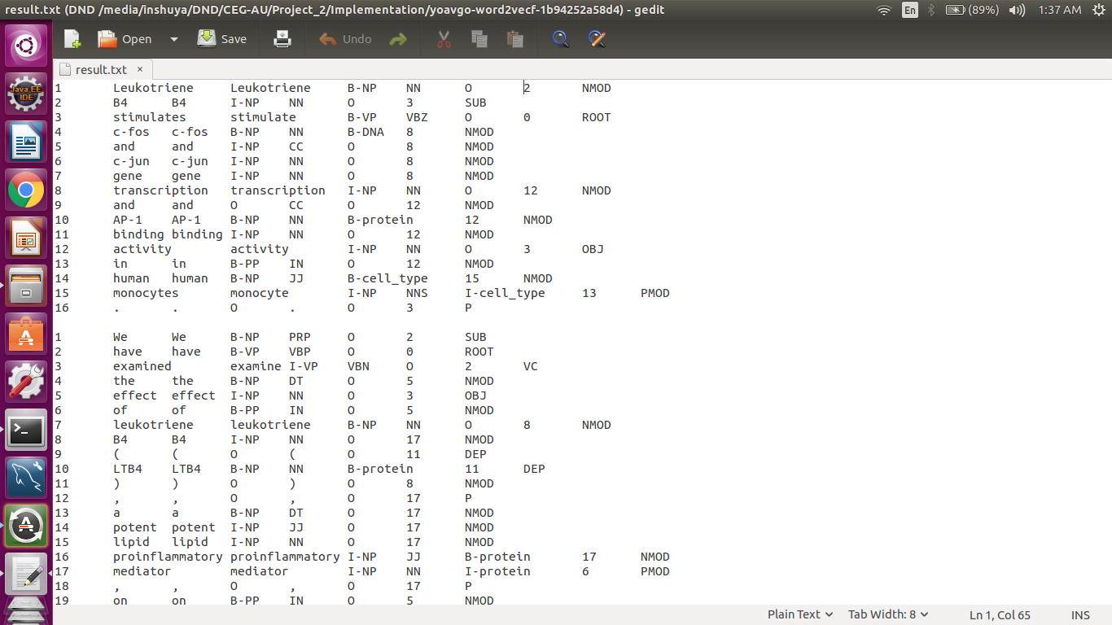
Output - Screenshot
Dependency Parsed Sentences

Slide 17
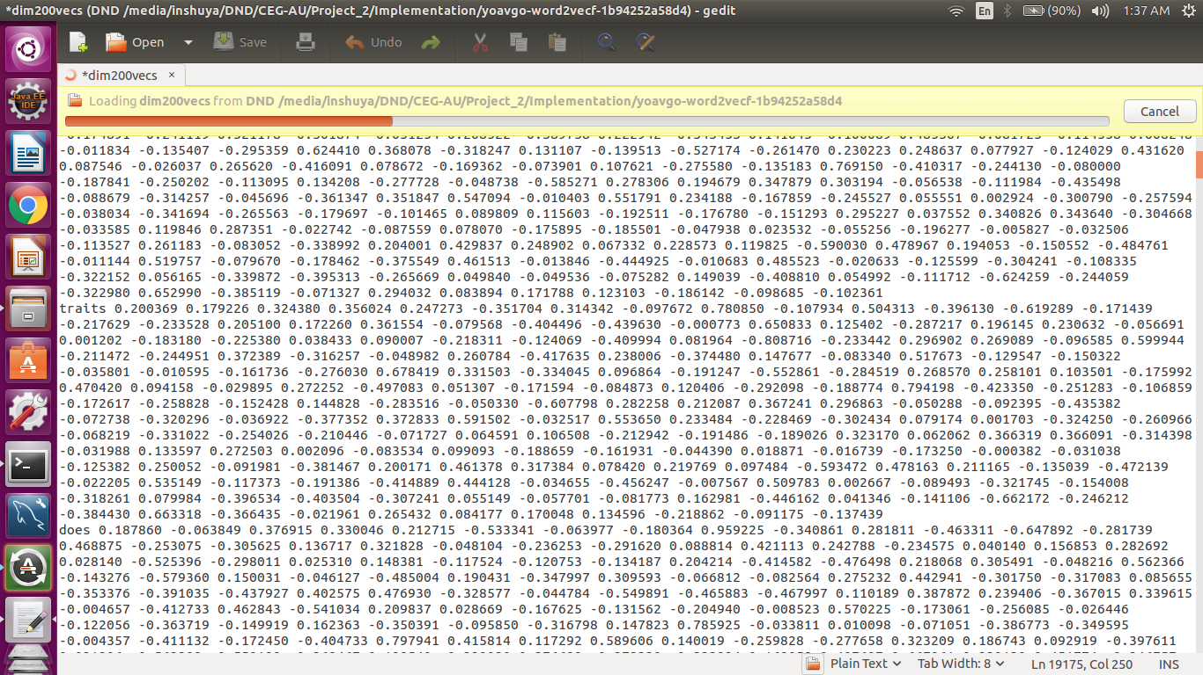
Output - Screenshot
Dependency-based Word embedding

Slide 18
3. Trigger Identification and Classification
Input :
Linear Context-Based Word Representation of trigger words
Dependency-Based Word Representation
PubMed/MEDLINE Corpus
Output : Identified Trigger words and their types
Algorithm :
Construct a look-up table for all the words in vocabulary
Concatenate the both forms of word-embedding to form distributed semantic feature vector
Train the Neural Network model to identify and categorize the triggers
Use the model to predict type of triggers words

Slide 19
Algorithm – Neural Network
3. Trigger Identification and Classification – Contd.
Decide the number of passes and hidden layers depending the on the size of the data
For each pass:
Do a forward propagation by updating the weights and bias variables
Calculate the loss
Do a back propagation by correcting and aiming to reduce the loss
Update the regularization terms
Update the gradient descent parameters
Assign the new parameters to the model
Repeat the process for various hidden layers
Use the best model to predict the triggers

Slide 20
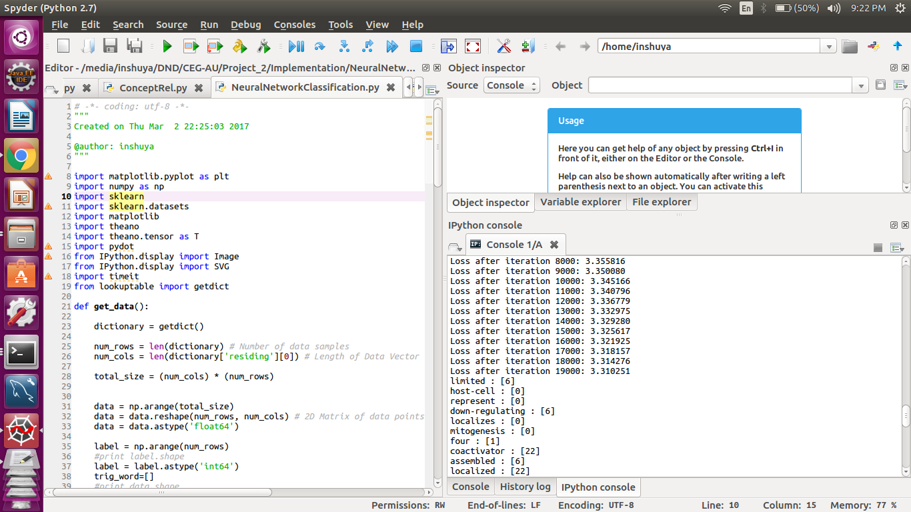
Output - Screenshot
Trigger word Classification

Slide 21
4. Argument Detection
Input :
Identified Trigger words and their types
PubMed/MEDLINE Corpus
Output : Identified Arguments(Events)
Algorithm :
Acquire the tree parsing of the sentences using Stanford's corenlp.
Convert this to numerical vector representing the fragment counts in the tree
Acquire the topic model of each sentence using LDA topic modelling
Represent the topics as vectors of length of number of topics(here 20)
Merge two of these vectors
Use it as input to KNN algorithm to find similar sentences
Use the neighbors with similar structure to implement the following algorithm

Slide 22
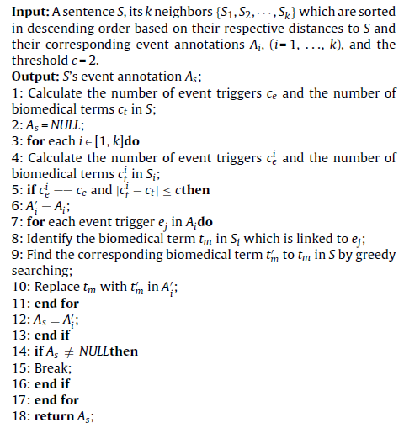
4. Argument Detection – Contd.
Annotation Algorithm

Slide 23
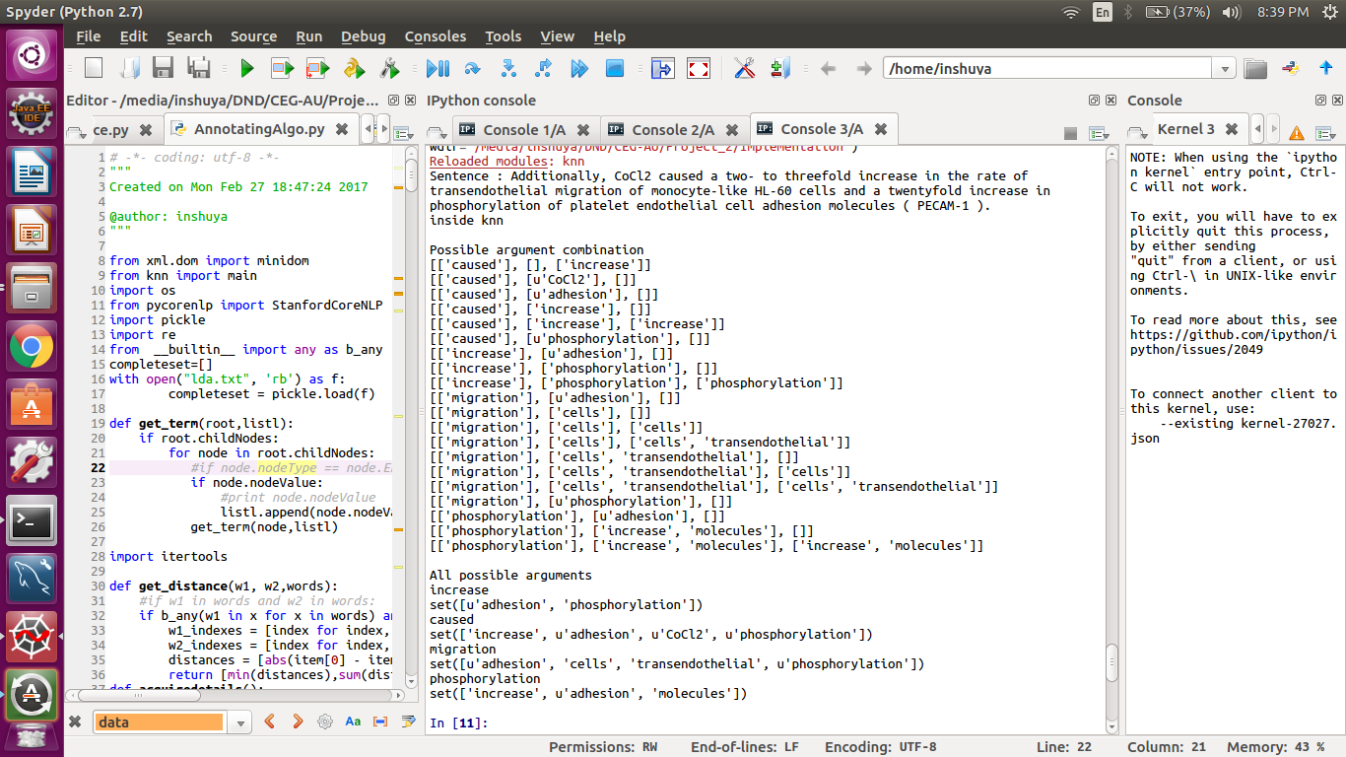
Output - Screenshot
Annotated Sentences with Events

Slide 24
5. Feature-Based Relation Extraction
Input :
Identified Events ( Trigger Words and Arguments )
PubMed/MEDLINE Corpus
GENIA Event Corpus
Output : Related Events
Algorithm :
Identify the pair of trigger candidates in same sentence or connected by co referent subject/object from different sentence
Acquire trigger-specific features like lexical and syntactic features
Acquire relation-specific features like conjunction dependency relation, head word lemma, etc.
Create a model with SVM
Use the above feature set as input
Consider the feature as data point
Find out the hyper-plane which separates the data into classes

Slide 25
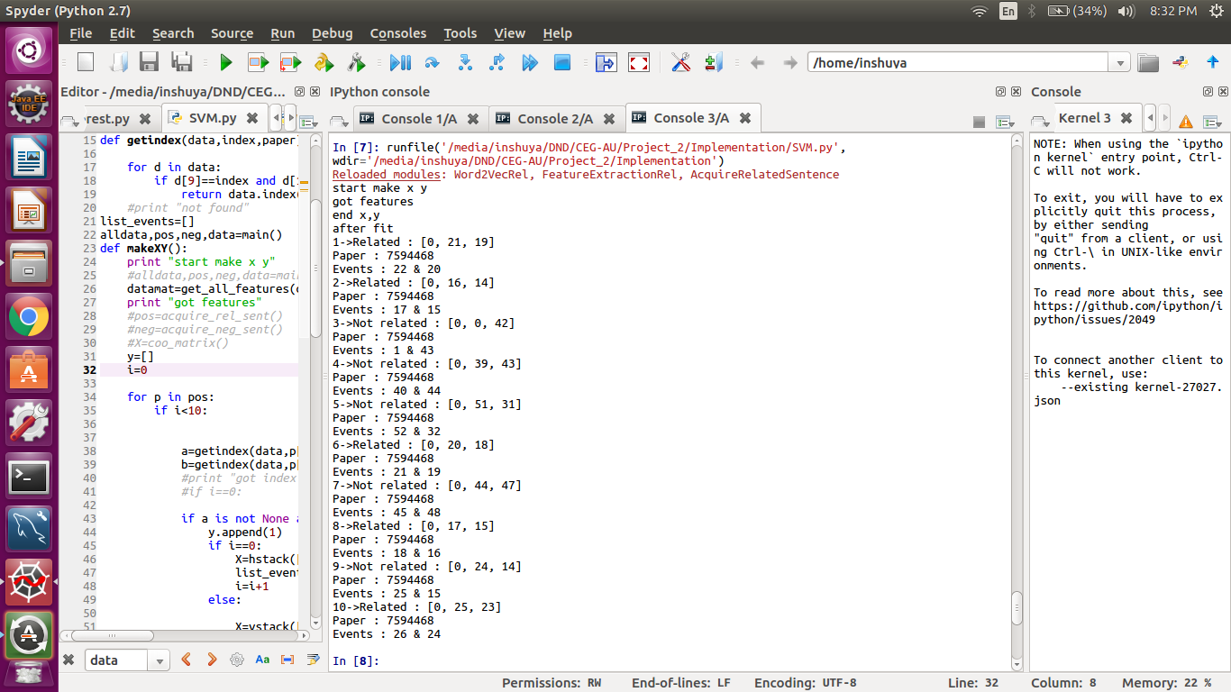
Output - Screenshot
Feature-based Event-Event Relation Discovery

Slide 26
6. Concept-Based Relation Extraction
Input :
Identified Events ( Trigger Words and Arguments )
PubMed/MEDLINE Corpus
Phase I’s result
Output : Related Events
Algorithm :
Identify possible event pairs
Identify all the concepts available in the events
Use the result of phase I to check whether there is any relation between the concepts in the events
If found, mark the events are related

Slide 27
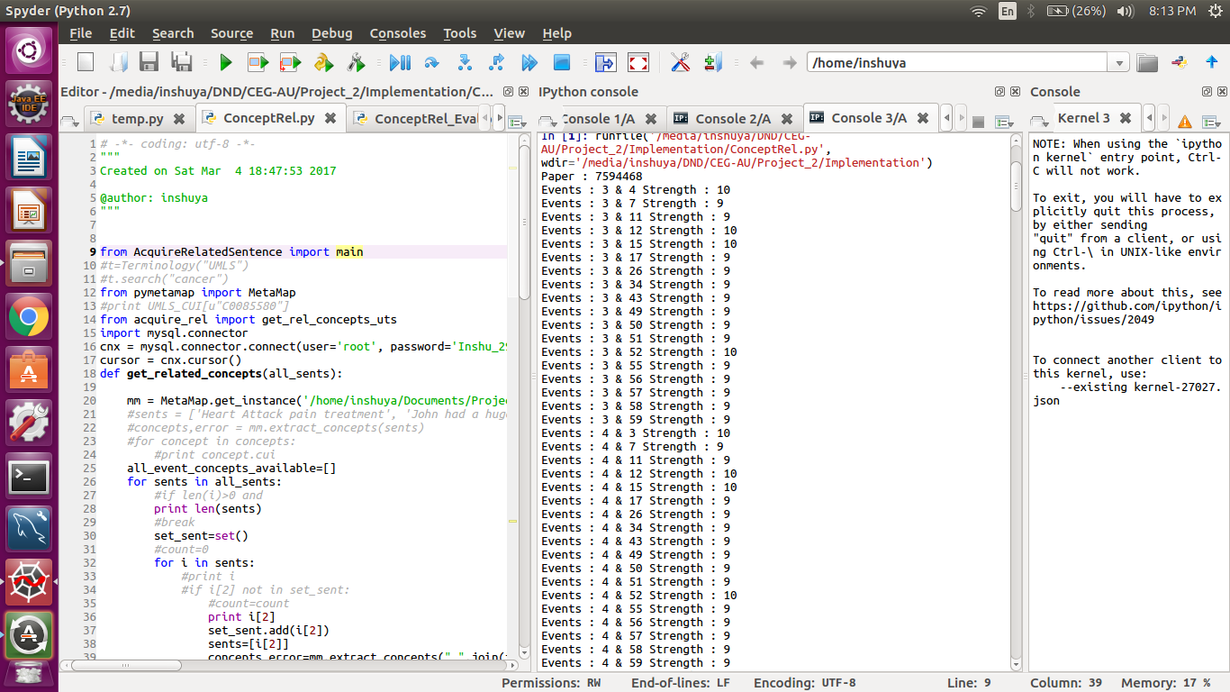
Output - Screenshot
Concept based Event-Event Relation Discovery

Slide 28
7. Word Embedding-Based Relation Extraction
Input :
Identified Events ( Trigger Words and Arguments )
PubMed/MEDLINE Corpus
GENIA Event Corpus
Output : Related Events
Algorithm :
Identify (S,R,T) triplets
Acquire linear context word-embedding for source and target
Find the embedding for the trigger and argument words
Sum the learnt embedding
Merge the embedding of both source and target
Let that be the input and class be whether they are related or not
Apply Random-Forest classifier to learn relation model
Repeated bagging (B times)
Select a random sample from training set
Fit decision trees to these samples
Average/take majority vote of result

Slide 29
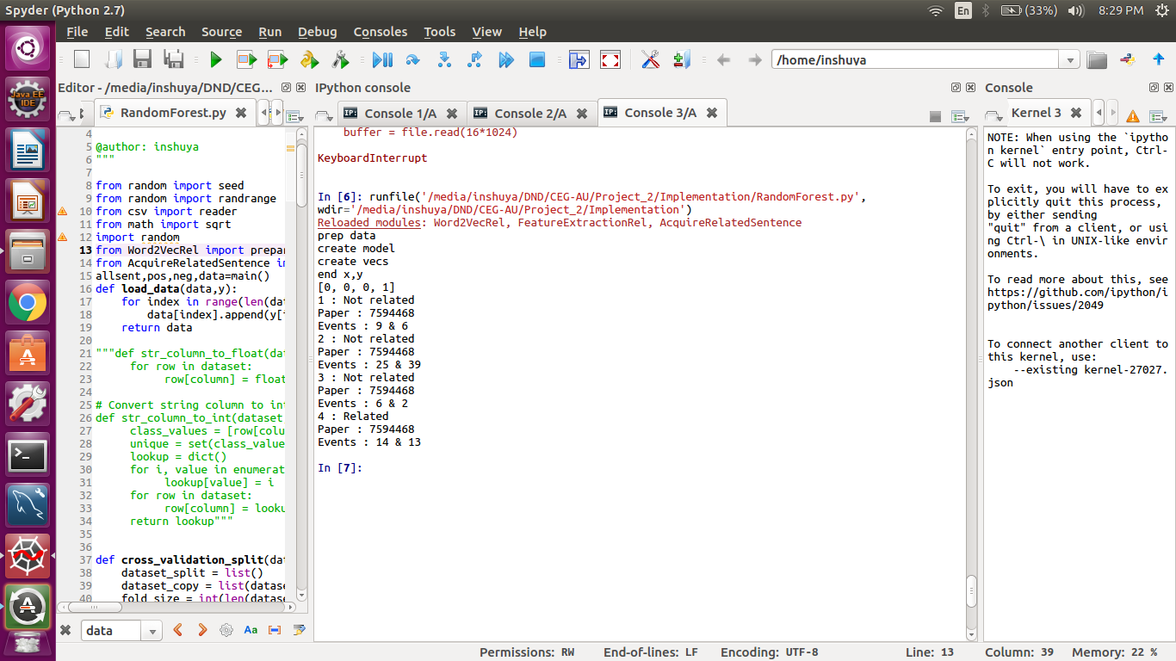
Output - Screenshot
Word-embedding based Event-Event Relation Discovery

Slide 30
8. Event-based Biomedical Document Retrieval
Input :
PubMed Documents
Events and its type identified in each document
Relations between the events identified
Output :
Documents retrieved based on the events in it
Steps Involved:
Use Lucene to build a retrieval system
Indexing should be done with the help of events(triggers and arguments) and type of events
Show the top 10 documents
Highlight the events which were searched for in the document
Also show the related events present in the document
Search can be done based on events and event types

Slide 31
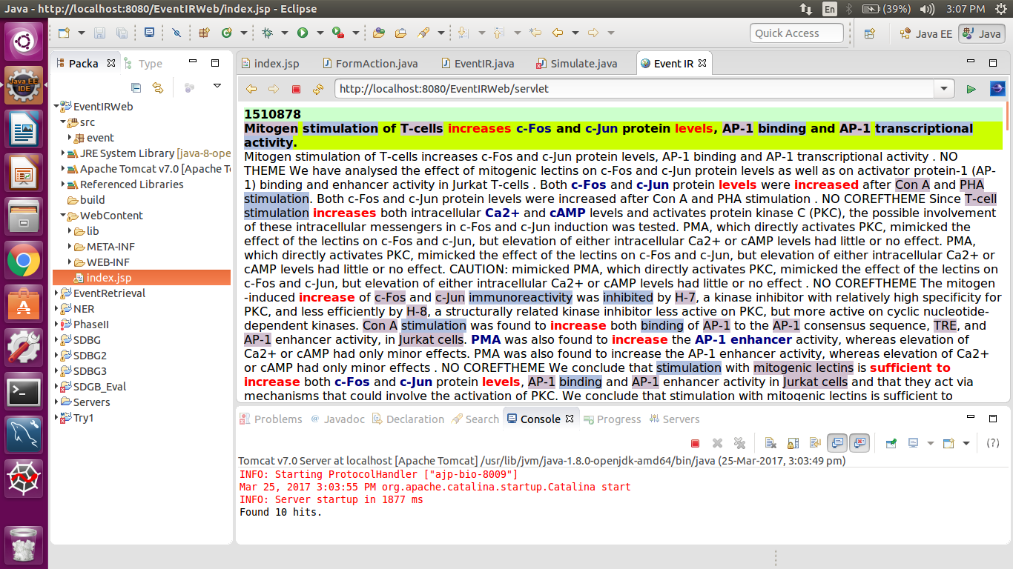
Output - Screenshot
Event-based Document Retrieval

Slide 32
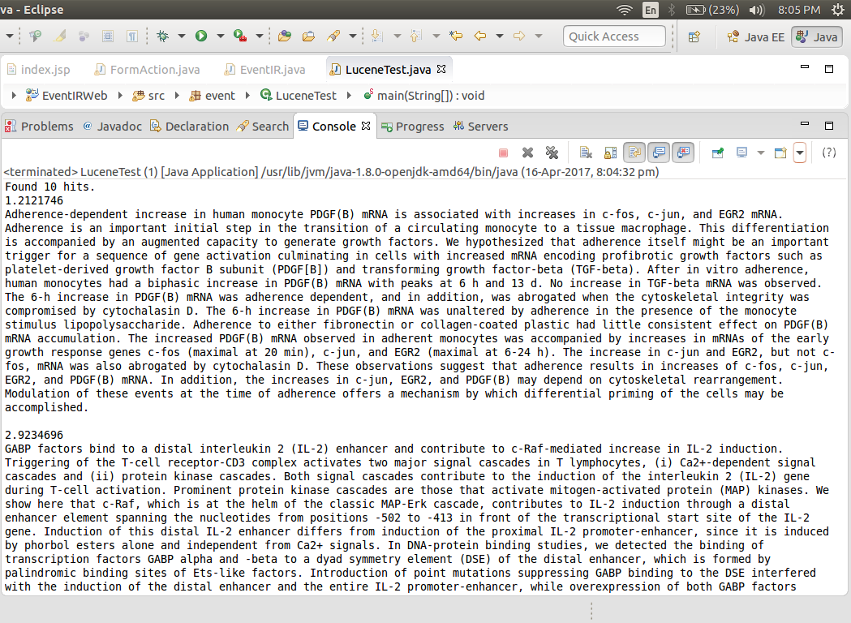
Comparison of Retrieval System
Event-Based Document Retrieval
Content-Based Document Retrieval

Slide 33





Evaluation Metrics
Actual/Predicted | Class A | Class B
Class A | TP | FN
Class B | FP | TN
Where TP-True Positive, FP-False Positive, TN- True Negative, FN- False Negative,
P-Total no. of positive samples, N-Total no. of negative samples,
C is trigger class,
MacroAvg is Macro Averaging of F1 score,
MicroAvg is Micro Averaging of F1 score.

Slide 34
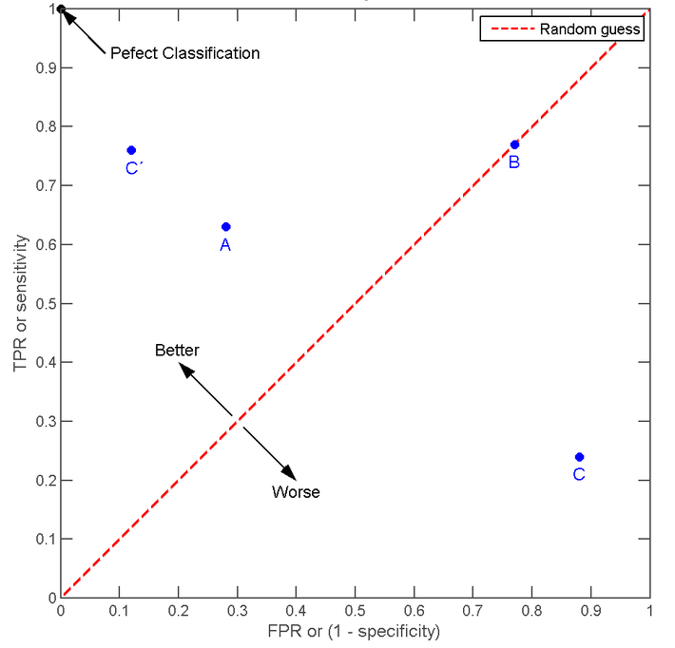

Evaluation Metrics
Where AUC – Area under the Curve
ROC - Receiver Operating Characteristic
General ROC Graph

Slide 35
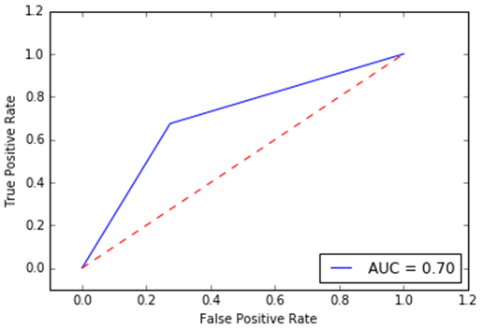
Evaluation Results Trigger Word Classification
Number of Hidden Layers | AUC
1 | 0.7
2 | 0.7
3 | 0.7
4 | 0.69
5 | 0.7
ROC Curve– 3 Hidden Layers

Slide 36
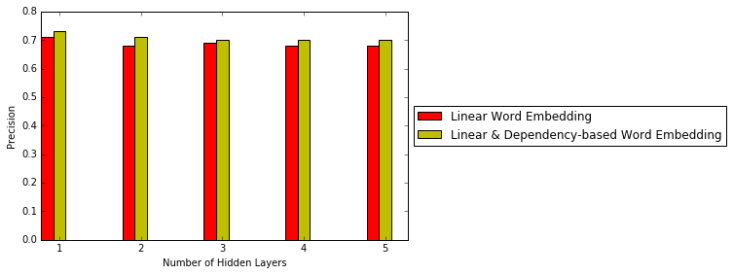
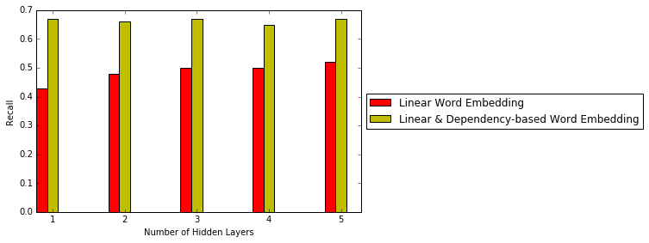
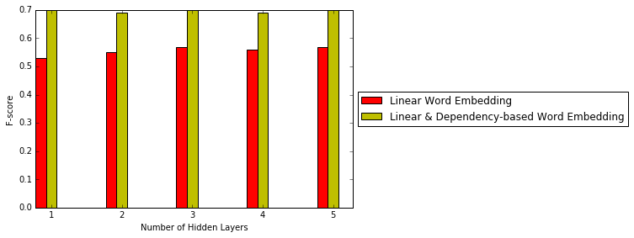
Trigger Word Classification Comparison with Existing System
Precision Comparison
Recall Comparison
F-Score Comparison

Slide 37
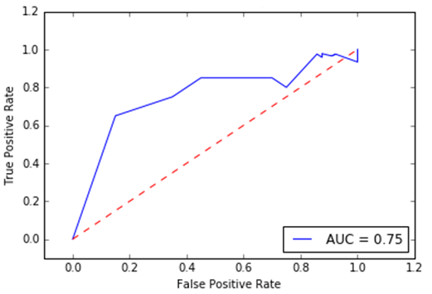
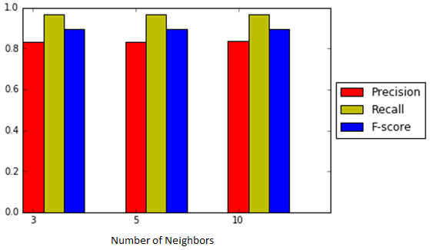
Evaluation Results – Argument Identification
Performance
Precision – Recall – F-Score
ROC Curve

Slide 38
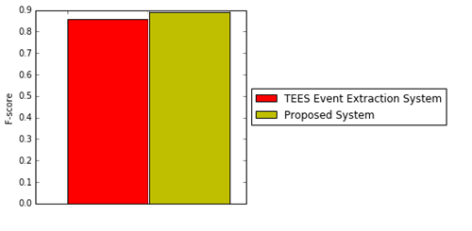
Event Discovery Comparison with Existing System
Event Extraction System
F-Score Comparison

Slide 39
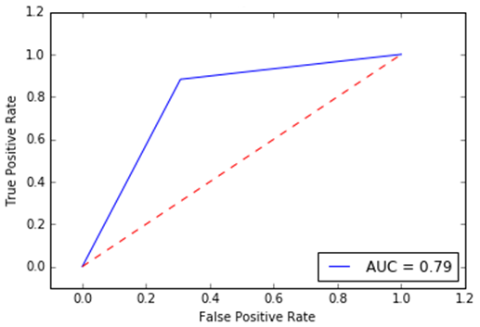
Evaluation Results Feature-Based Relation Extraction
Macro-Averaged Precision : 0.844
Macro-Averaged Recall : 0.752
Macro-Averaged F-Score : 0.793
ROC Curve

Slide 40
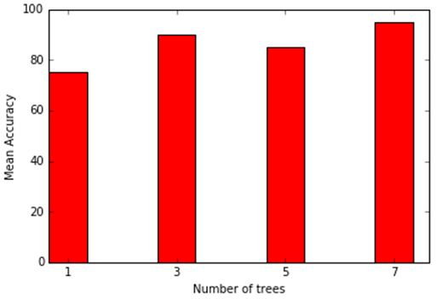
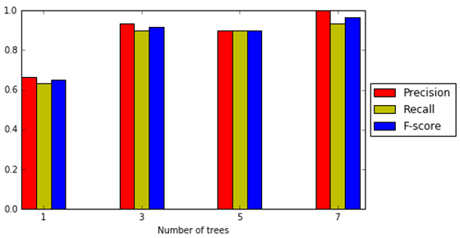
Evaluation Results Word Embedding-Based Relation Extraction
Performance
Precision – Recall – F-score
Accuracy

Slide 41
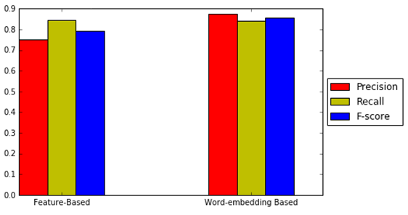
Comparison of Feature-Based and Word Embedding-Based Relation Extraction
Performance
Precision – Recall – F-Score

Slide 42
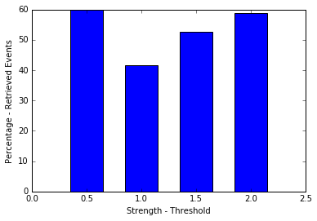
Concept-based Relation Extraction Inference
Percentage of New Relations Extracted

Slide 43
Test Cases
ID | Module Name | Assumptions | Input | Expected Output
1_01 | Linear Context-Based Word Representation | - | GENIA Event Corpus | - Linear Context-Based word-embedding vectors are learnt - Similarity between words like ‘treat’, ‘treating', ‘treated’ should be high
2_01 | Dependency-Based Word Representation | - | MEDLINE Corpus | -Dependency-Based word-embedding vectors are learnt - Similarity between words like ‘cure', ‘treat‘ and ‘heal’ should be high
3_01 | Trigger Identification and Classification | Context-Based and Dependency-Based Word Representation are acquired | -MEDLINE Corpus - Test data : Set of sentences with no events | - No trigger words identified
3_02 | Trigger Identification and Classification | Context-Based and Dependency-Based Word Representation are acquired | -MEDLINE Corpus - Test data : Set of sentences with events | All possible trigger words identified Type of trigger word is discovered
3_03 | Trigger Identification and Classification | Context-Based and Dependency-Based Word Representation are acquired | -MEDLINE Corpus - Test data : Set of sentences with and without events | All possible triggers identified Type of trigger word is discovered - High Precision, Recall and F-score
4_01 | Argument Detection | - Trigger words and their types are identified | - MEDLINE Corpus -Test data : Sentence with simple event is provided | - Single argument event is detected

Slide 44
Test Cases – Contd.
ID | Module Name | Assumptions | Input | Expected Output
4_02 | Argument Detection | - Trigger words and their types are identified | - MEDLINE Corpus -Test data : Sentence with complex event is provided | - Multiple arguments event is detected
4_03 | Argument Detection | - Trigger words and their types are identified | - MEDLINE Corpus -Test data : Sentence with single and complex event is provided | - Single and Multiple arguments event is detected - High Precision, Recall and F-score
5_01 | Feature-Based Relation Extraction | - Events are identified | - MEDLINE Corpus - GENIA Event Corpus - Test data : Set of sentences with events and relations among them | - All possible relations between the events are discovered
5_02 | Feature-Based Relation Extraction | - Events are identified | - MEDLINE Corpus - GENIA Event Corpus - Test data : Set of sentences with events and no relations among them | - No relations between the events should be discovered
5_03 | Feature-Based Relation Extraction | - Events are identified | - MEDLINE Corpus - GENIA Event Corpus - Test data : Set of sentences with events. Few with relations, few without relations. | - All possible relations between the events are discovered - High Precision, Recall and F-score
6_01 | Concept-Based Relation Extraction | - Events are identified | - MEDLINE Corpus, Phase I’s result - Test data : Set of sentences with events and relations among them | - All possible relations between the events are discovered

Slide 45
Test Cases – Contd.
ID | Module Name | Assumptions | Input | Expected Output
6_02 | Concept-Based Relation Extraction | - Events are identified | - MEDLINE Corpus, Phase I’s result - Test data : Set of sentences with events and no relations among them | - No relations or hidden relations between the events should be discovered
7_01 | Word Embedding-Based Relation Extraction | - Events are identified | - MEDLINE Corpus - GENIA Event Corpus - Test data : Set of sentences with events and relations among them | - All possible relations between the events are discovered
7_02 | Word Embedding-Based Relation Extraction | - Events are identified | - MEDLINE Corpus - GENIA Event Corpus - Test data : Set of sentences with events and no relations among them | - No relations between the events should be discovered
7_03 | Word Embedding-Based Relation Extraction | - Events are identified | - MEDLINE Corpus - GENIA Event Corpus - Test data : Set of sentences with events. Few with relations, few without relations. | - All possible relations between the events are discovered - High Precision, Recall and F-score

Slide 46
References
Bishan Yang and Tom Mitchell, "Joint Extraction of Events and Entities within a Document Context", Carnegie Mellon University, 2016.
Deyu Zhou and Dayou Zhong, "A semi-supervised learning framework for biomedical event extraction based on hidden topics." in Journal of Artificial Intelligence in Medicine (ELSEVIER), Vol. 64, No.1, pp. 51-58, 2015.
Dirk Weissenborn, Michael Schroeder and George Tsatsaronis, "Discovering relations between indirectly connected biomedical concepts" in Journal of biomedical semantics, Vol. 6, No.1, pp. 1-19, 2015.
Geoffrey E Hinton et al., "Improving neural networks by preventing co-adaptation of feature detectors" in arXiv preprint arXiv, 2012.
Granroth-Wilding, Mark, and Stephen Clark, " What Happens Next? Event Prediction Using a Compositional Neural Network Model." in Proceedings of the Thirtieth AAAI Conference on Artificial Intelligence, 2016.
Jian Wang et al., "Biomedical event trigger detection by dependency-based word embedding" in Journal of BMC Medical Genomics, Vol. 9, No. 4, pp. 123-133, 2016.

Slide 47
References – Contd.
Kilicoglu Halil, "Inferring Implicit Causal Relationships in Biomedical Literature", in Journal of Biomedical Natural Language Processing, Vol. 15, No. 1, pp. 46-55, 2016.
Makoto Miwa et al., "Extracting semantically enriched events from biomedical literature" in Journal of BMC Bioinformatics, Vol. 13, No.108,pp. 1-24, 2012.
Matthew D. Zeiler, "ADADELTA: an adaptive learning rate method" in arXiv preprint arXiv, 2012.
Omer Levy and Yoav Goldberg, "Dependency-Based Word Embeddings" in ACL, 2014.
Sampo Pyysalo et al., "Event extraction across multiple levels of biological organization" in Journal of Bioinformatics, Vol. 28, No.18, pp. 575-581, 2012.
Stephanie L Hyland, Theofanis Karaletsos, and Gunnar Rätsch, "A generative model of words and relationships from multiple sources", in International Workshop on Embeddings and Semantics, 2015.
Tomas Mikolov et al., "Distributed representations of words and phrases and their compositionality" in Advances in neural information processing systems, 2013

